Slide 1
Computer Networks Module-1
Dr. R. Prashanth
SCOPE
prashanth.rajam@vitap.ac.in

Slide 2
Advantages of Distributed processing
Security: It provides limited interaction that a user can have with the entire system. For example, a bank allows the users to access their own accounts through an ATM without allowing them to access the bank's entire database.
Faster problem solving: Multiple computers can solve the problem faster than a single machine working alone.
Security through redundancy: Multiple computers running the same program at the same time can provide the security through redundancy. For example, if four computers run the same program and any computer has a hardware error, then other computers can override it.

Slide 3
How Does a Computer Network Work?
Basics building blocks of a Computer network are Nodes and Links. A Network Node can be illustrated as Equipment for Data Communication like a Modem, Router, etc., or Equipment of a Data Terminal like connecting two computers or more.
Link in Computer Networks can be defined as wires or cables or free space of wireless networks.
The working of Computer Networks can be simply defined as rules or protocols which help in sending and receiving data via the links which allow Computer networks to communicate.
Each device has an IP Address, that helps in identifying a device.

Slide 4
Basic Terminologies of Computer Networks
Network: A network is a collection of computers and devices that are connected together to enable communication and data exchange.
Nodes: Nodes are devices that are connected to a network. These can include computers, Servers, Printers, Routers, Switches, and other devices.
Protocol: A protocol is a set of rules and standards that govern how data is transmitted over a network. Examples of protocols include TCP/IP, HTTP, and FTP.
Topology: Network topology refers to the physical and logical arrangement of nodes on a network. The common network topologies include bus, star, ring, mesh, and tree.
Service Provider Networks: These types of Networks give permission to take Network Capacity and Functionality on lease from the Provider. Service Provider Networks include Wireless Communications, Data Carriers, etc.

Slide 5
IP Address: An IP address is a unique numerical identifier that is assigned to every device on a network. IP addresses are used to identify devices and enable communication between them.
DNS: The Domain Name System (DNS) is a protocol that is used to translate human-readable domain names (such as www.google.com) into IP addresses that computers can understand.
Firewall: A firewall is a security device that is used to monitor and control incoming and outgoing network traffic. Firewalls are used to protect networks from unauthorized access and other security threats.

Slide 6
Internet
The Internet, sometimes called simply "the Net," is a worldwide system of computer networks -- a network of networks in which users at any one computer can, if they have permission, get information from any other computer (and sometimes talk directly to users at other computers).
(Simply)
Internet is a global network that connects billions of computers across the world with each other and to the World Wide Web.

Slide 7
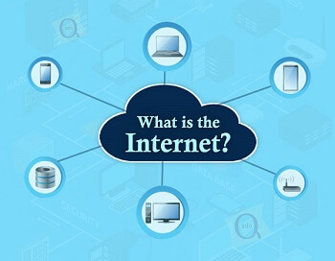
It uses standard internet protocol suite (TCP/IP) to connect billions of computer users worldwide.
It is set up by using cables such as optical fibers and other wireless and networking technologies.
At present, internet is the fastest mean of sending or exchanging information and data between computers across the world.

Slide 8
It is believed that the internet was developed by "Defense Advanced Projects Agency" (DARPA) department of the United States. And, it was first connected in 1969.
Internet is called a network as it creates a network by connecting computers and servers across the world using routers, switches and telephone lines, and other communication devices and channels.
So, it can be considered a global network of physical cables such as copper telephone wires, fiber optic cables, tv cables, etc.
Furthermore, even wireless connections like 3G, 4G, or Wi-Fi make use of these cables to access the Internet.

Slide 9
How does internet work?
The internet works with the help of clients and servers. A device such as a laptop, which is connected to the internet is called a client, not a server as it is not directly connected to the internet.
However, it is indirectly connected to the internet through an Internet Service Provider (ISP) and is identified by an IP address, which is a string of numbers.
An IP address acts as the shipping address of your device. The IP address is provided by your ISP, and you can see what IP address your ISP has given to your system.

Slide 10
A server is a large computer that stores websites. It also has an IP address. A place where a large number of servers are stored is called a data center. The server accepts requests send by the client through a browser over a network (internet) and responds accordingly.
To access the internet we need a domain name, which represents an IP address number, i.e., each IP address has been assigned a domain name. For example, youtube.com, facebook.com, paypal.com are used to represent the IP addresses.
Domain names are created as it is difficult for a person to remember a long string of numbers.
However, internet does not understand the domain name, it understands the IP address, so when you enter the domain name in the browser search bar, the internet has to get the IP addresses of this domain name from a huge phone book, which is known as DNS (Domain Name Server).

Slide 11
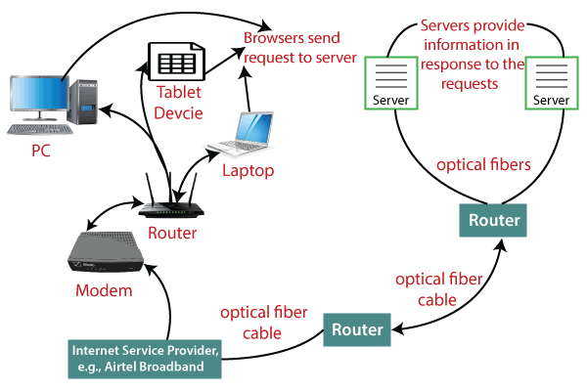
How does internet work?

Slide 12
When you turn on your computer and type a domain name in the browser search bar, your browser sends a request to the DNS server to get the corresponding IP address. After getting the IP address, the browser forwards the request to the respective server.
Once the server gets the request to provide information about a particular website, the data starts flowing. The data is transferred through the optical fiber cables in digital format or in the form of light pulses. As the servers are placed at distant places, the data may have to travel thousands of miles through optical fiber cable to reach your computer.

Slide 13
The optical fiber is connected to a router, which converts the light signals into electrical signals. These electrical signals are transmitted to your laptop using an Ethernet cable. Thus, you receive the desired information through the internet, which is actually a cable that connects you with the server.
Furthermore, if you are using wireless internet using wifi or mobile data, the signals from the optical cable are first sent to a cell tower and from where it reaches to your cell phone in the form of electromagnetic waves.

Slide 14
Network architecture
Network architecture refers to a network’s structural and logical layout. It describes how the network devices are connected and the rules that govern data transfer between them.
There are many ways to approach network architecture design, which depend on the purpose and size of the network.
Wide area networks (WAN), for example, refer to a group of interconnected networks often spanning large distances. Its network architecture will be vastly different from that of a local area network (LAN) of a smaller office branch.

Slide 15
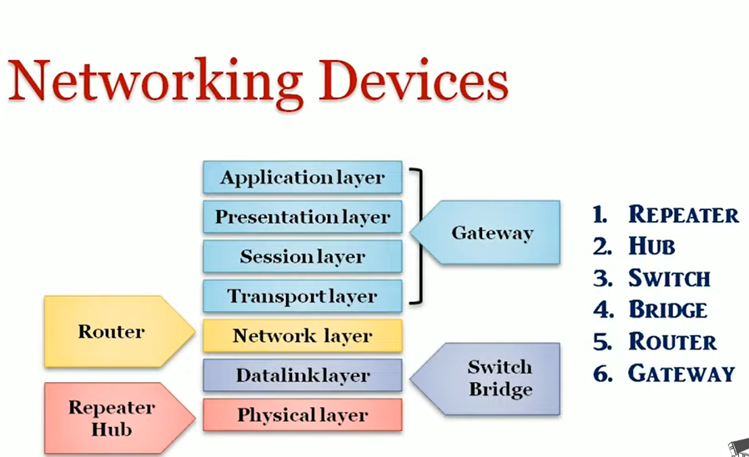

Slide 16
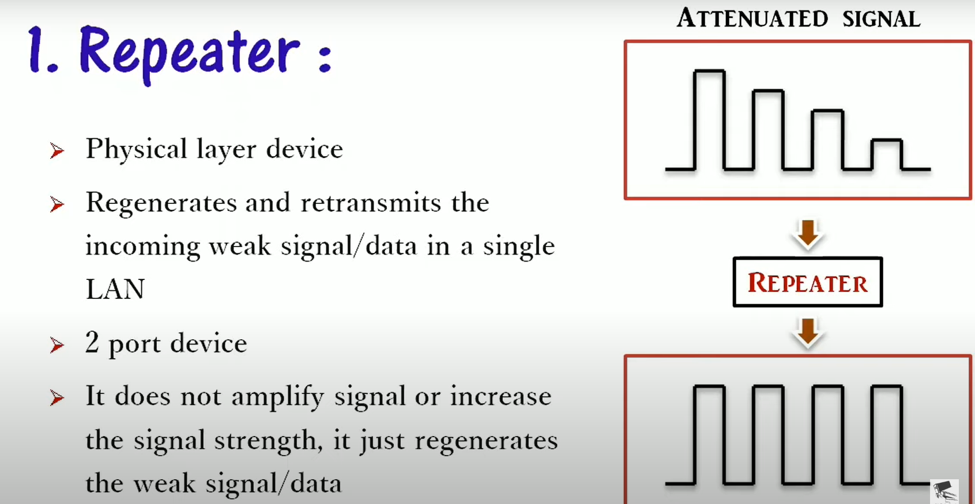

Slide 17
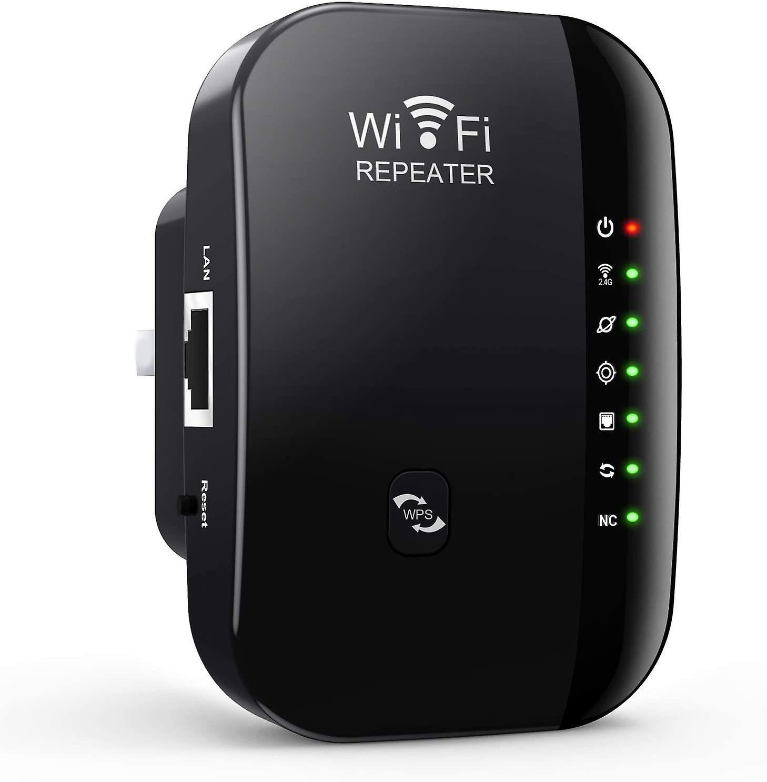

Slide 18
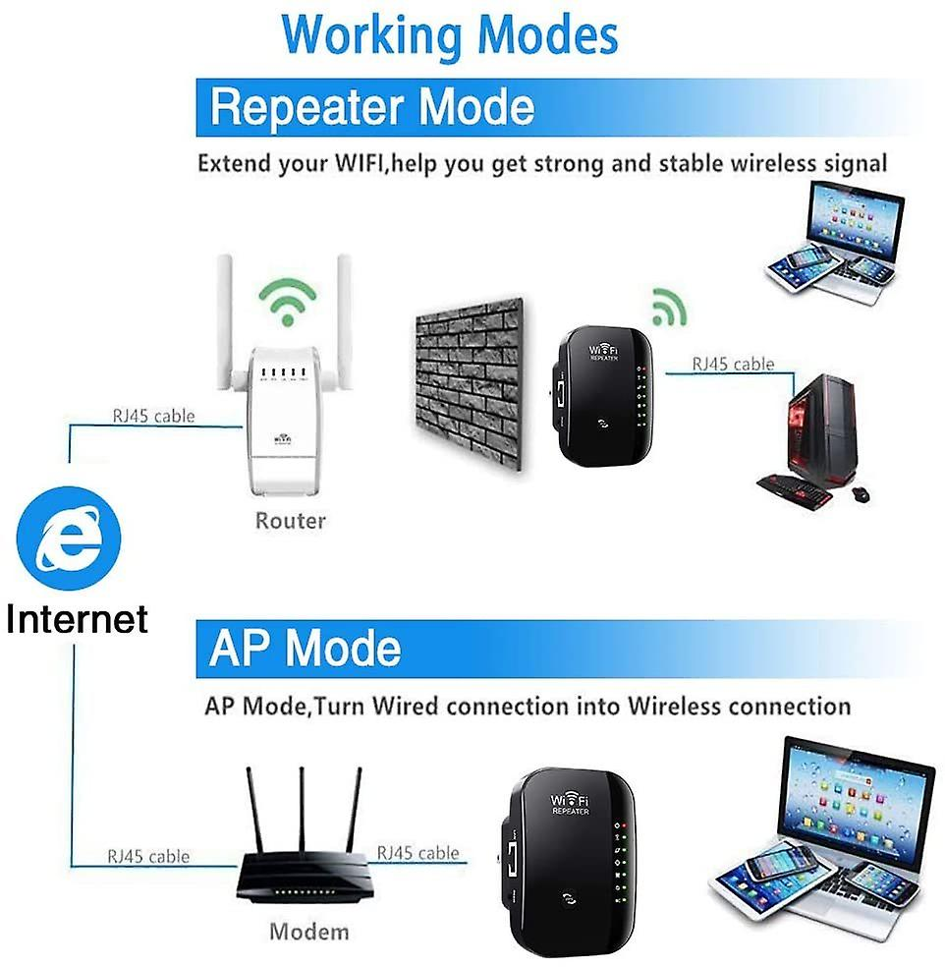

Slide 19
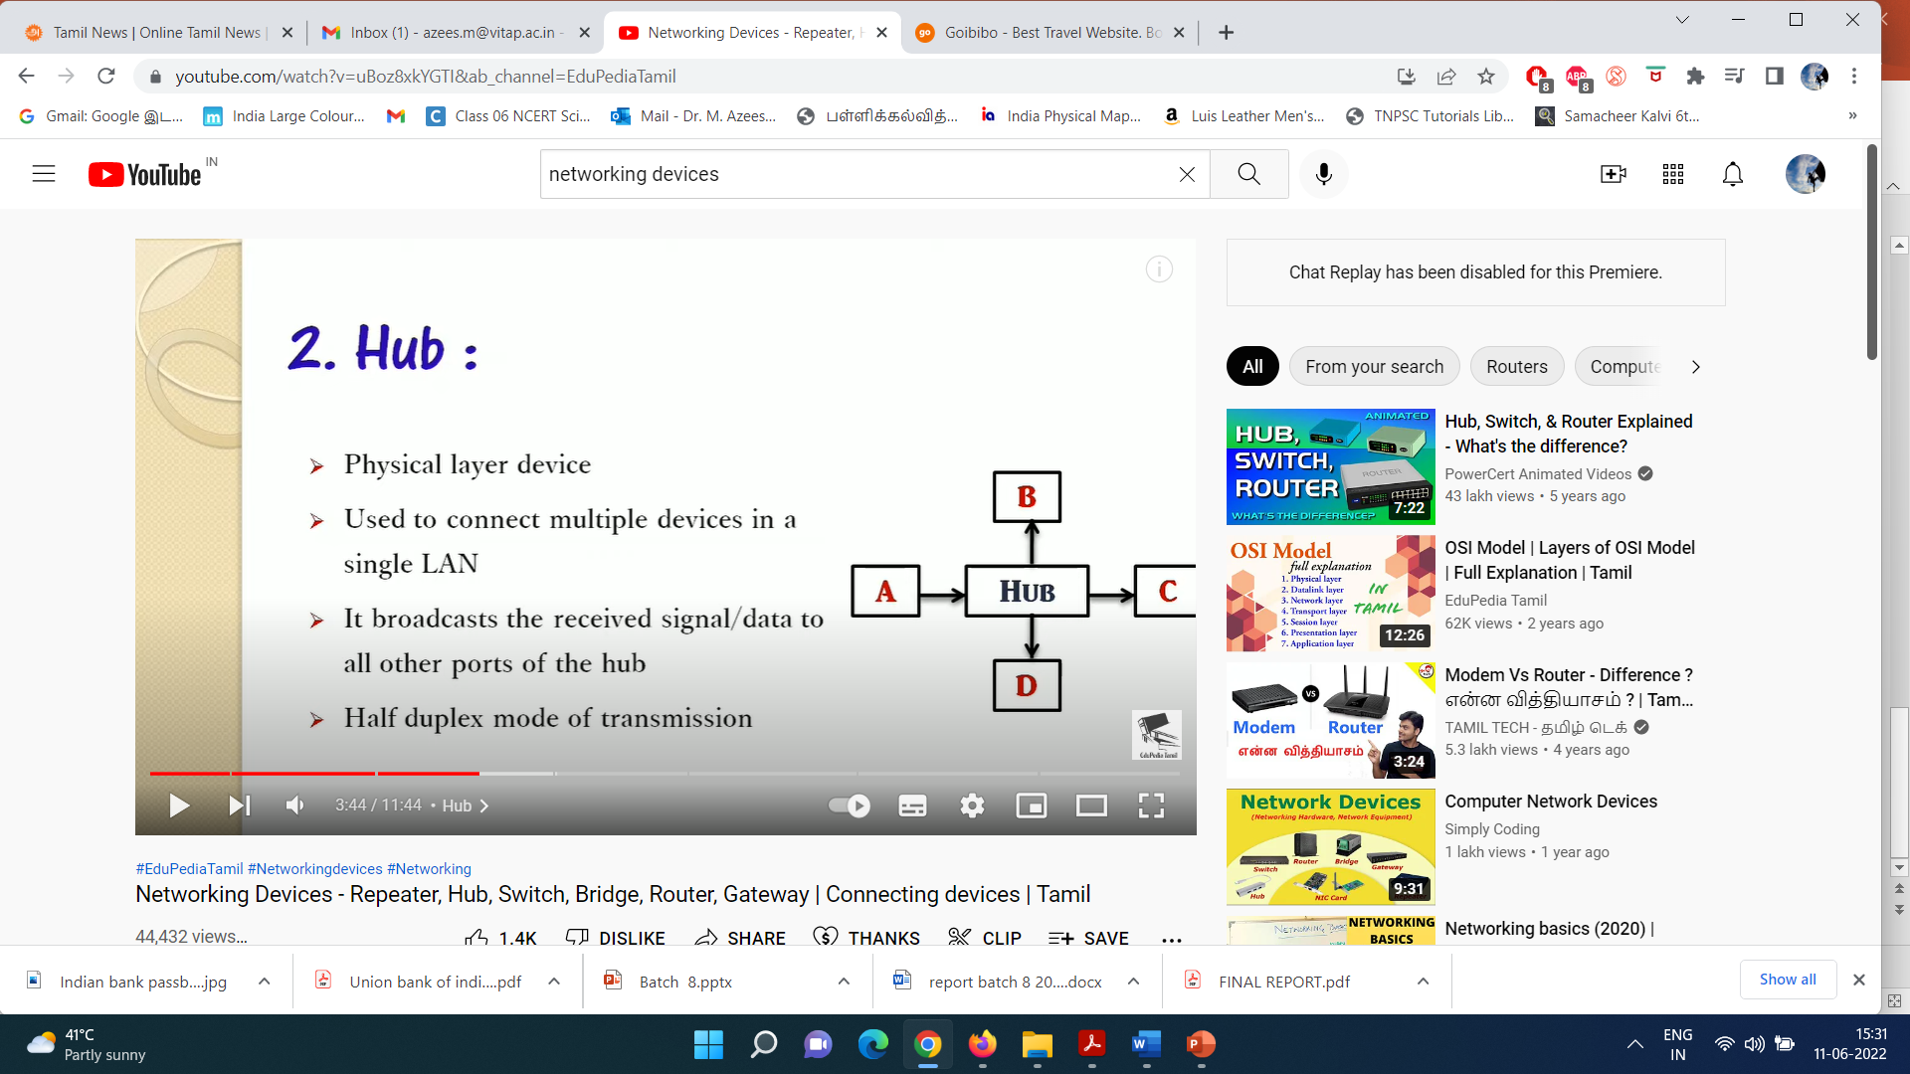

Slide 20
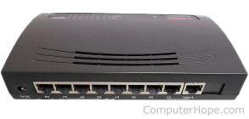
When referring to a network, a hub is the most basic networking device that connects multiple computers or other network devices.
Hub operates at the physical layer of OSI model. It is the simplest networking device hence has low cost.
Basically, a hub is a repeater with multiple ports. The function of a hub in networking is similar to the repeater.

Slide 21
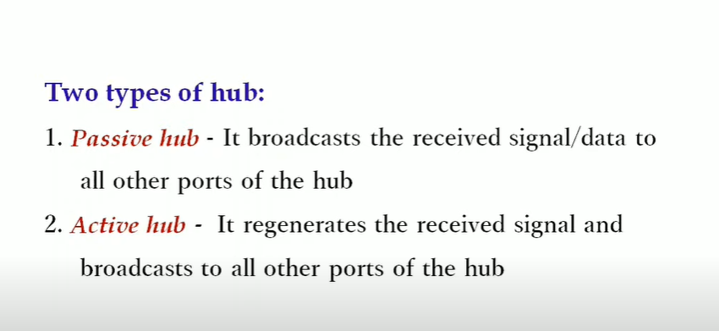

Slide 22
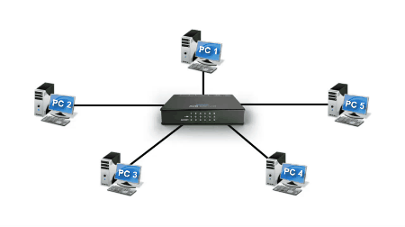

Slide 23
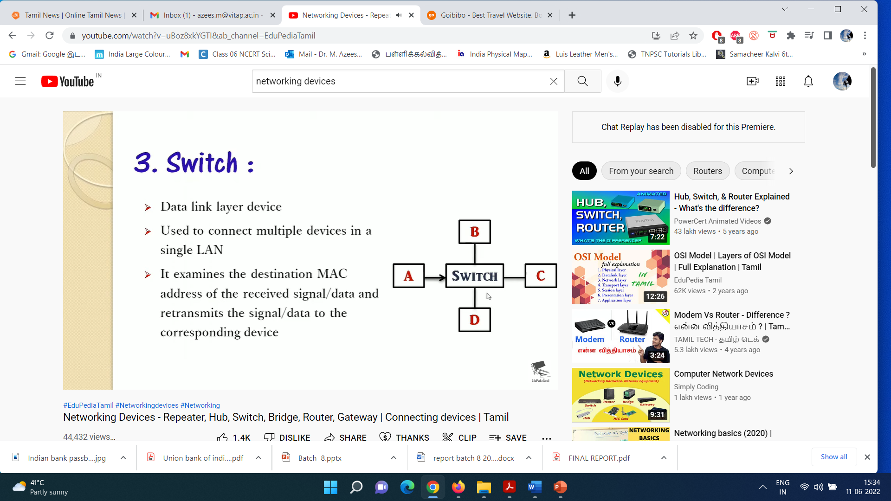
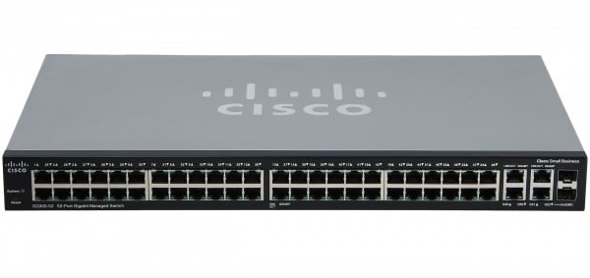

Slide 24
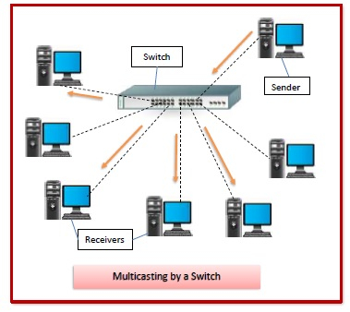
Switches refer to the networking devices that operate at an OSI model’s layer 2 or data link layer.
They establish connections between networked devices and employ packet switching to transmit, receive, or forward data packets or frames over the network.
There are numerous ports on a switch where computers can be connected.
A network switch evaluates the destination address of each data frame that enters one of its ports, runs any necessary checks, and then sends the frame to the appropriate device(s). It enables broadcast, multicast, and unicast communications.

Slide 25
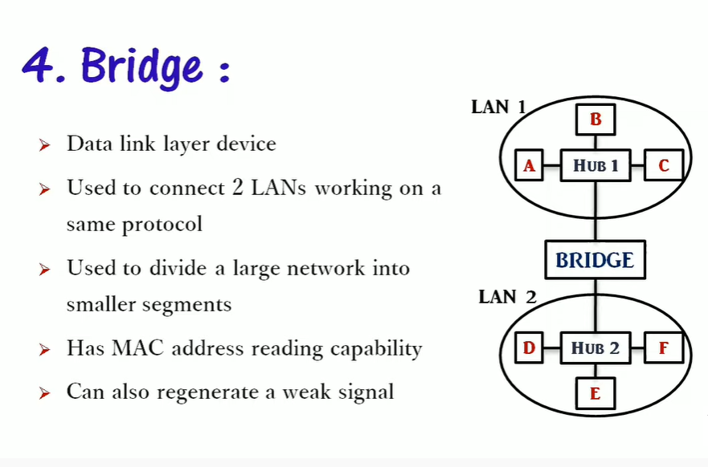

Slide 26
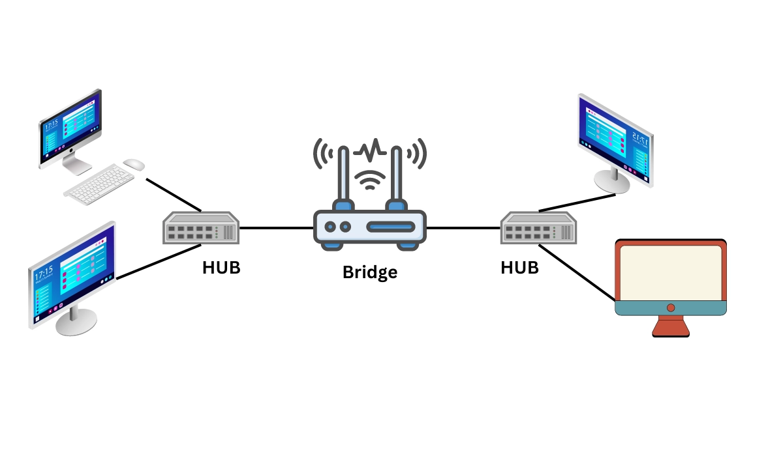
A bridge is a network device that connects two or more LANs (local area networks) to form a larger LAN. Network bridging refers to the process of aggregating networks. A bridge connects the various components, making them appear to be part of a single network.

Slide 27
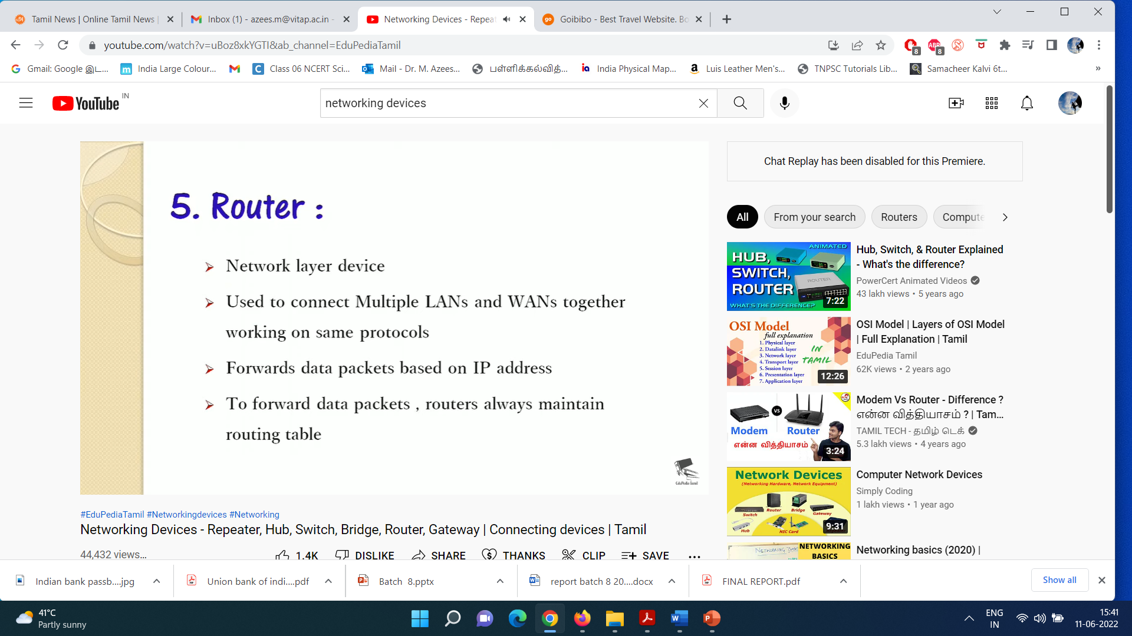

Slide 28
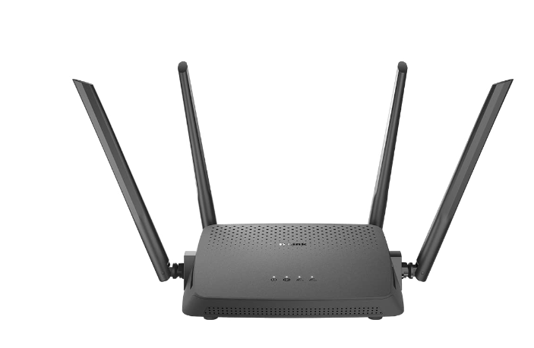
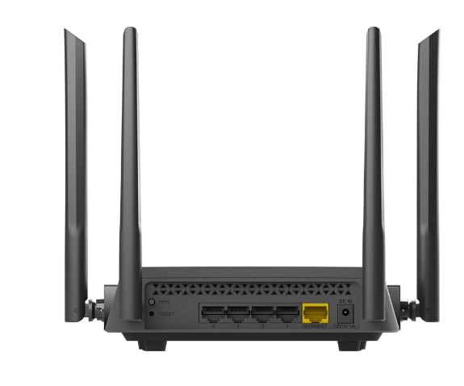

Slide 29
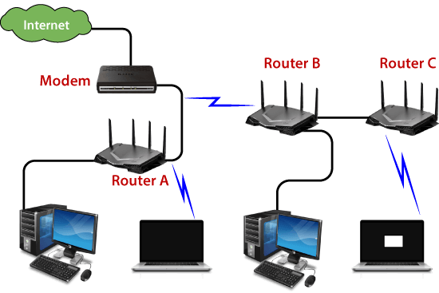
A router analyzes a destination IP address of a given packet header and compares it with the routing table to decide the packet's next path.
The list of routing tables provides directions to transfer the data to a particular network destination. They have a set of rules that compute the best path to forward the data to the given IP address.

Slide 30
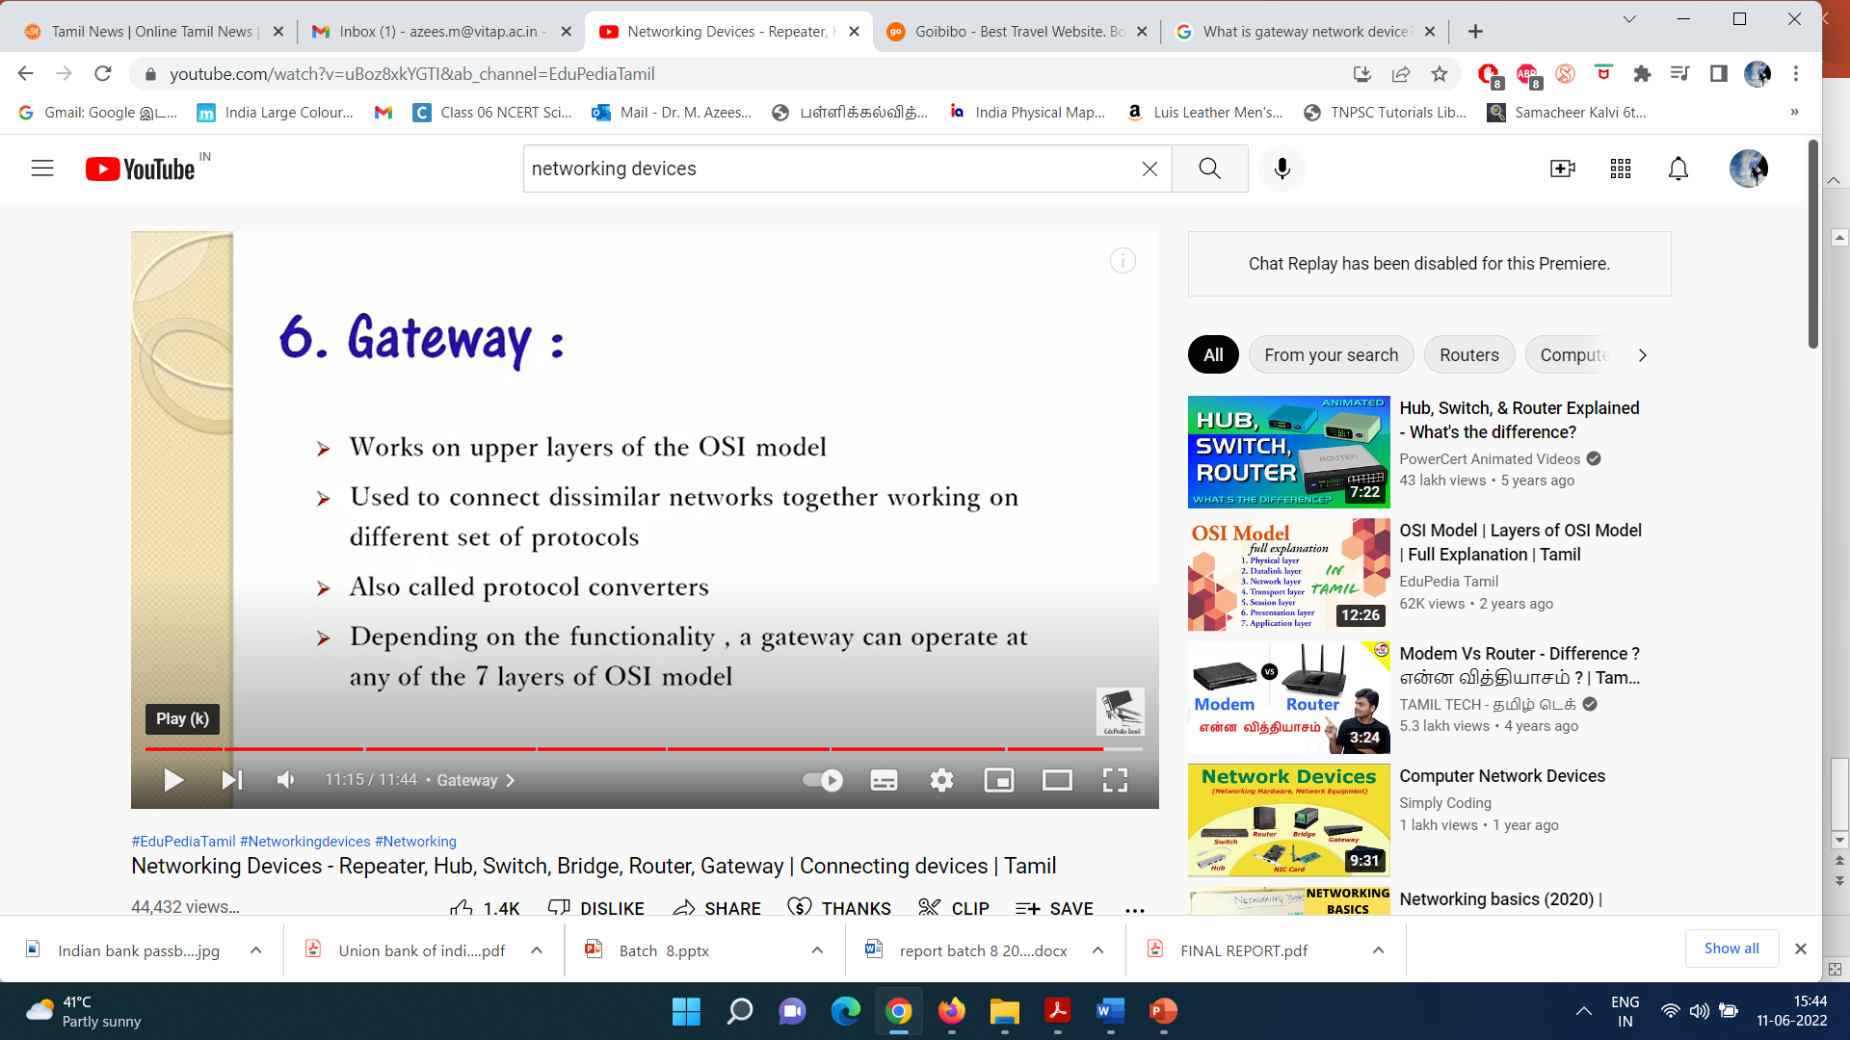

Slide 31
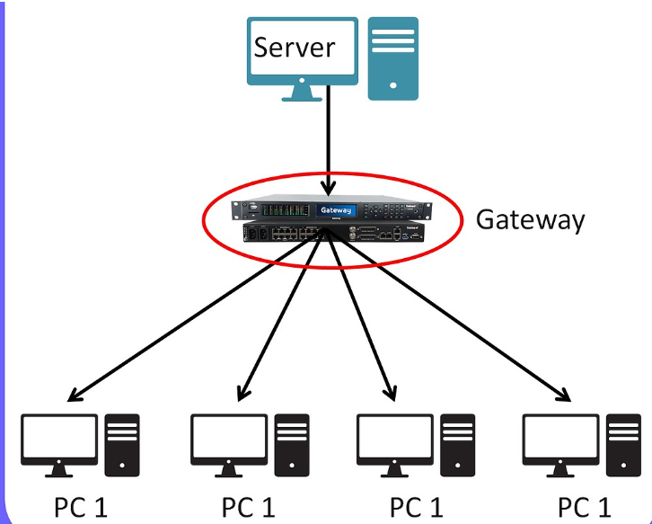
A network gateway is a device or node that connects disparate networks by translating communications from one protocol to another.

Slide 32
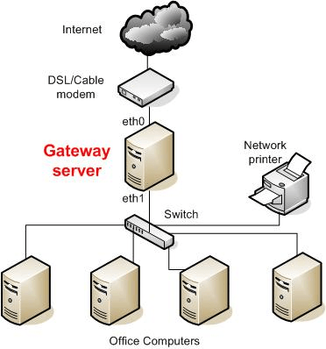
Network gateways are used to interconnect networks, including those with different communications protocols. They serve as the point of entry to a network and operate at various network layers.
Gateway servers are hardware devices and gateway nodes are associated with routers and switches.

Slide 33
OSI model

Slide 34
Introduction
The Open Systems Interconnections (OSI) model describes seven layers that computer systems use to communicate over a network
It was the first standard model for network communications, adopted by all major computer and telecommunication companies in the early 1980s
OSI was introduced in 1983 by representatives of the major computer and telecom companies, and was adopted by ISO as an international standard in 1984.

Slide 35
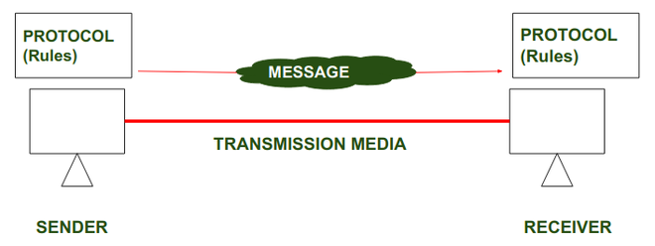
Protocol :
In Order to make communication successful between devices , some rules and procedures should be agreed upon at the sending and receiving ends of the system. Such rules and procedures are called as Protocols .

Slide 36
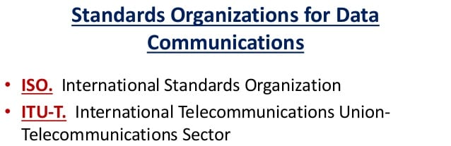

Slide 37
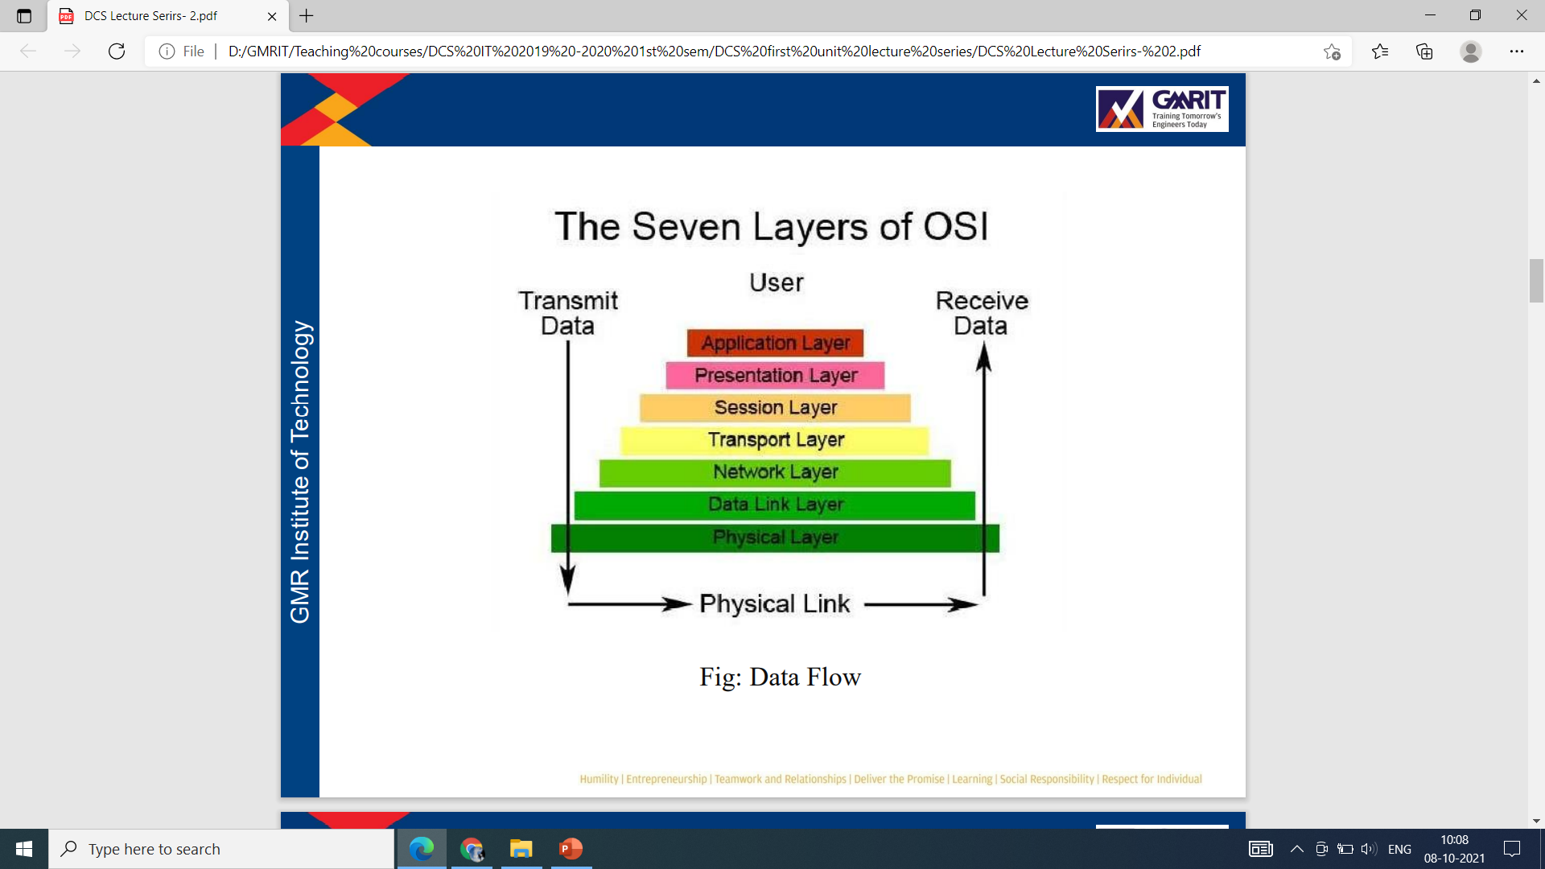
It is a 7-layer architecture with each layer having specific functionality to perform.
All these 7 layers work collaboratively to transmit the data from one person to another across the globe.

Slide 38
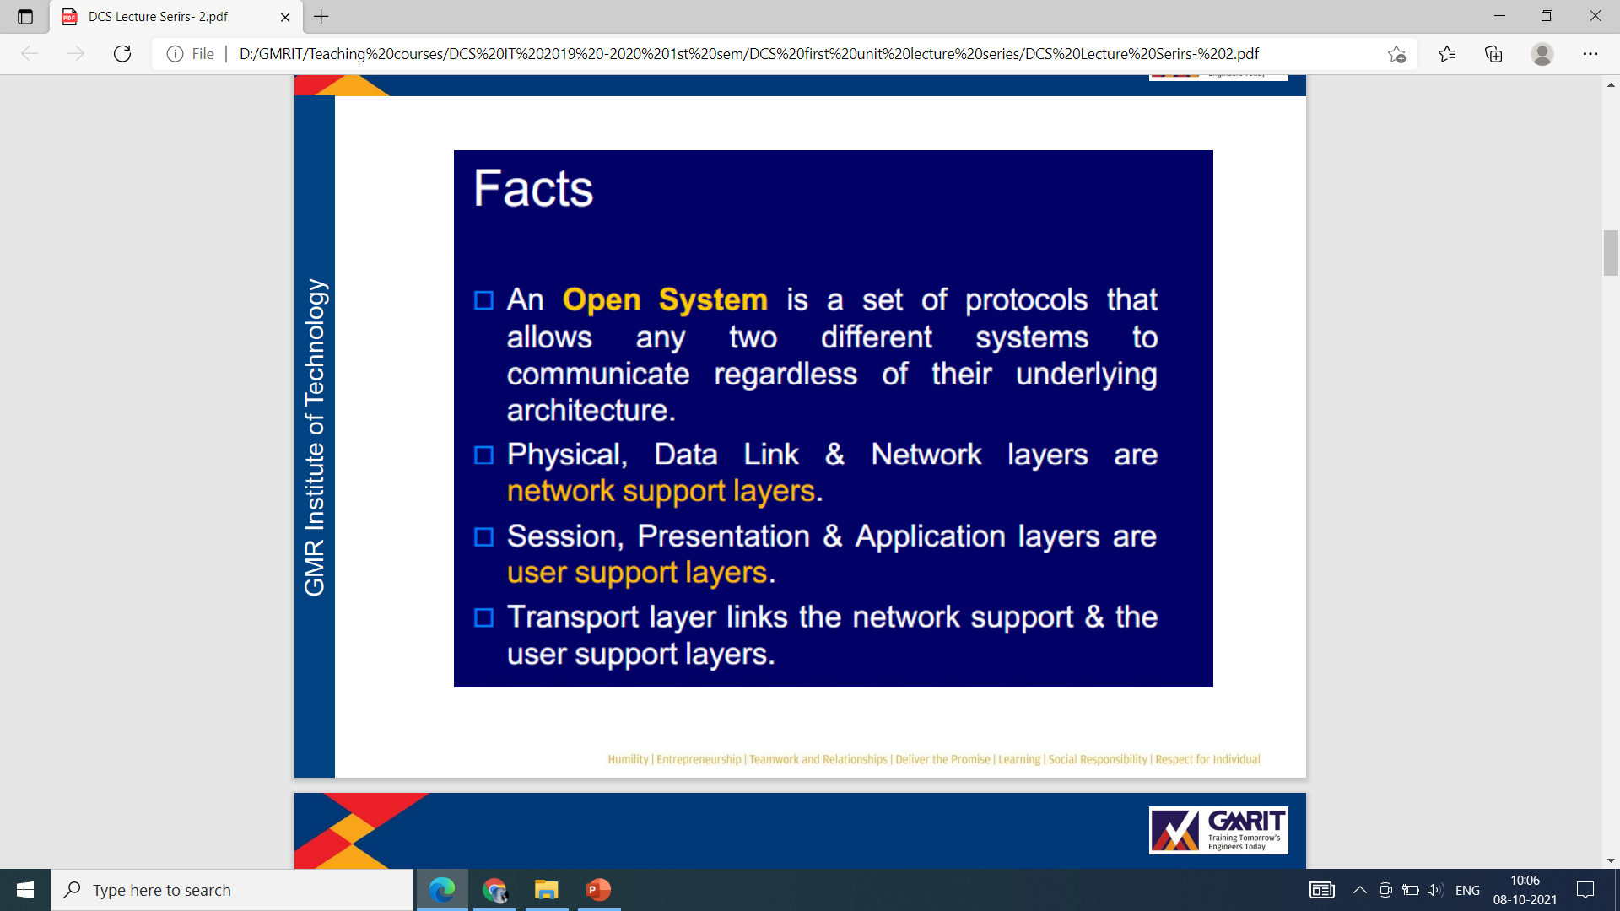

Slide 39
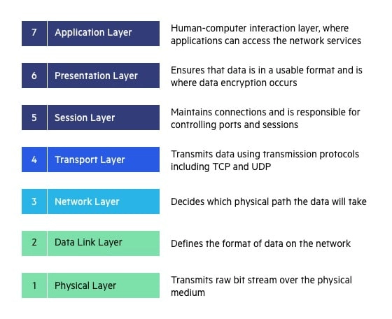
7-Layers-OSI Model

Slide 40
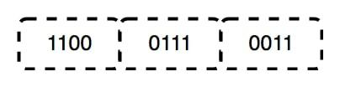
Layer 1-Physical layer
The lowest layer of the OSI reference model is the physical layer. It is responsible for the actual physical connection between the devices. The physical layer contains information in the form of bits.
It is responsible for transmitting individual bits from one node to the next.
When receiving data, this layer will get the signal received and convert it into 0s and 1s and send them to the Data Link layer, which will put the frame back together.

Slide 41
Functions of the Physical Layer
Bit synchronization: The physical layer provides the synchronization of the bits by providing a clock. This clock controls both sender and receiver thus providing synchronization at the bit level.
Bit rate control: The Physical layer also defines the transmission rate i.e. the number of bits sent per second.
Physical topologies: Physical layer specifies how the different, devices/nodes are arranged in a network i.e. bus, star, or mesh topology.
Transmission mode: Physical layer also defines how the data flows between the two connected devices. The various transmission modes possible are Simplex, half-duplex and full-duplex.
Hub, Repeater, Modem, and Cables are Physical Layer devices.

Slide 42
The data link layer is responsible for coding and decoding data packets — aka, ensuring communication between the network and physical layer happens.
This layer can be divided into two sub-layers: MAC layer (Media Access Control) and LLC layer (Logical Link Control).
The MAC sub-layer handles how the network accesses data and permissions to transmit data; the LLC sub-layer is in charge of flow control, checking errors, and synchronization of frames.
Examples of what’s at work in this layer include: Frame Relay, ATM, HDLC, PPP, FDDI, and IEEE 802.5/ 802.2, IEEE 802.3/802.2,

Slide 43
Layer 2-Data Link Layer
The data link layer is responsible for the node-to-node delivery of the message
The main function of this layer is to make sure data transfer is error-free from one node to another, over the physical layer
When a packet arrives in a network, it is the responsibility of the DLL to transmit it to the Host using its MAC address

Slide 44
Functions of the Data Link Layer
Framing: Framing is a function of the data link layer. It provides a way for a sender to transmit a set of bits that are meaningful to the receiver. This can be accomplished by attaching special bit patterns to the beginning and end of the frame.
Physical addressing: After creating frames, the Data link layer adds physical addresses (MAC addresses) of the sender and/or receiver in the header of each frame.
Error control: The data link layer provides the mechanism of error control in which it detects and retransmits damaged or lost frames.
Flow Control: The data rate must be constant on both sides else the data may get corrupted thus, flow control coordinates the amount of data that can be sent before receiving an acknowledgment.
Access control: When a single communication channel is shared by multiple devices, the MAC sub-layer of the data link layer helps to determine which device has control over the channel at a given time.

Slide 45
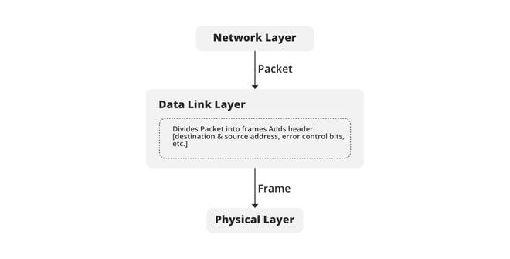

Slide 46
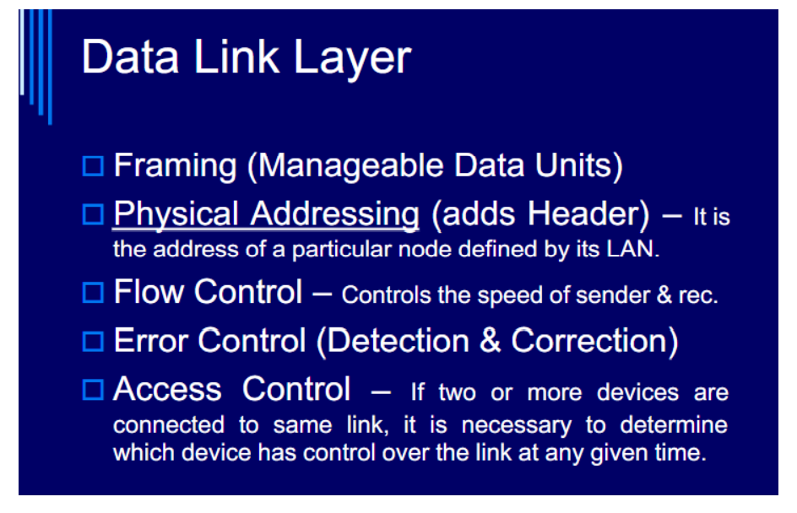

Slide 47
Layer 3-Network Layer
The network layer works for the transmission of data from one host to the other located in different networks.
It also takes care of packet routing i.e. selection of the shortest path to transmit the packet, from the number of routes available.
The sender & receiver’s IP addresses are placed in the header by the network layer.

Slide 48
Functions of the Network Layer
Routing: The network layer protocols determine which route is suitable from source to destination. This function of the network layer is known as routing.
Logical Addressing: To identify each device on Internetwork uniquely, the network layer defines an addressing scheme.
The sender & receiver’s IP addresses are placed in the header by the network layer. Such an address distinguishes each device uniquely and universally.

Slide 49
The network layer handles packet routing via logical addressing and switching functions. A network is a medium to which many nodes can be connected. Every node has an address.
When a node needs to transfer message to other nodes, it can merely provide the content of the massage and the address of the destination node, then the network will find the way to deliver the message to the destination node, possibly routing through other nodes.
If the message is too long, the network may split it into several segments at one node, sending them separately and reassembling the fragments at another node.

Slide 50
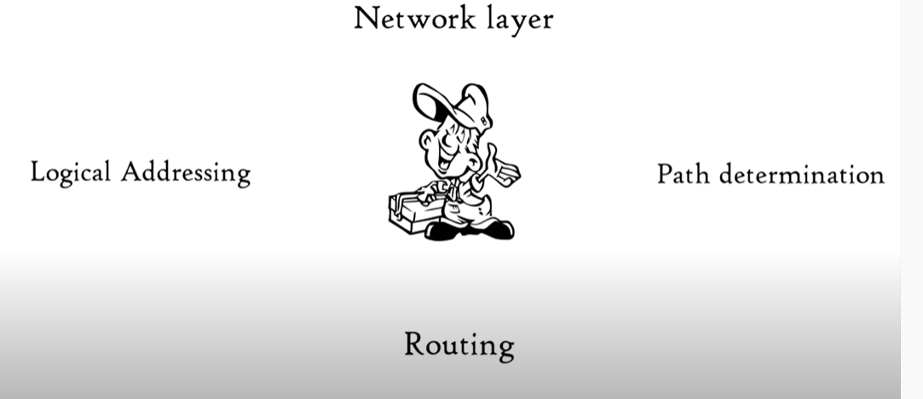

Slide 51
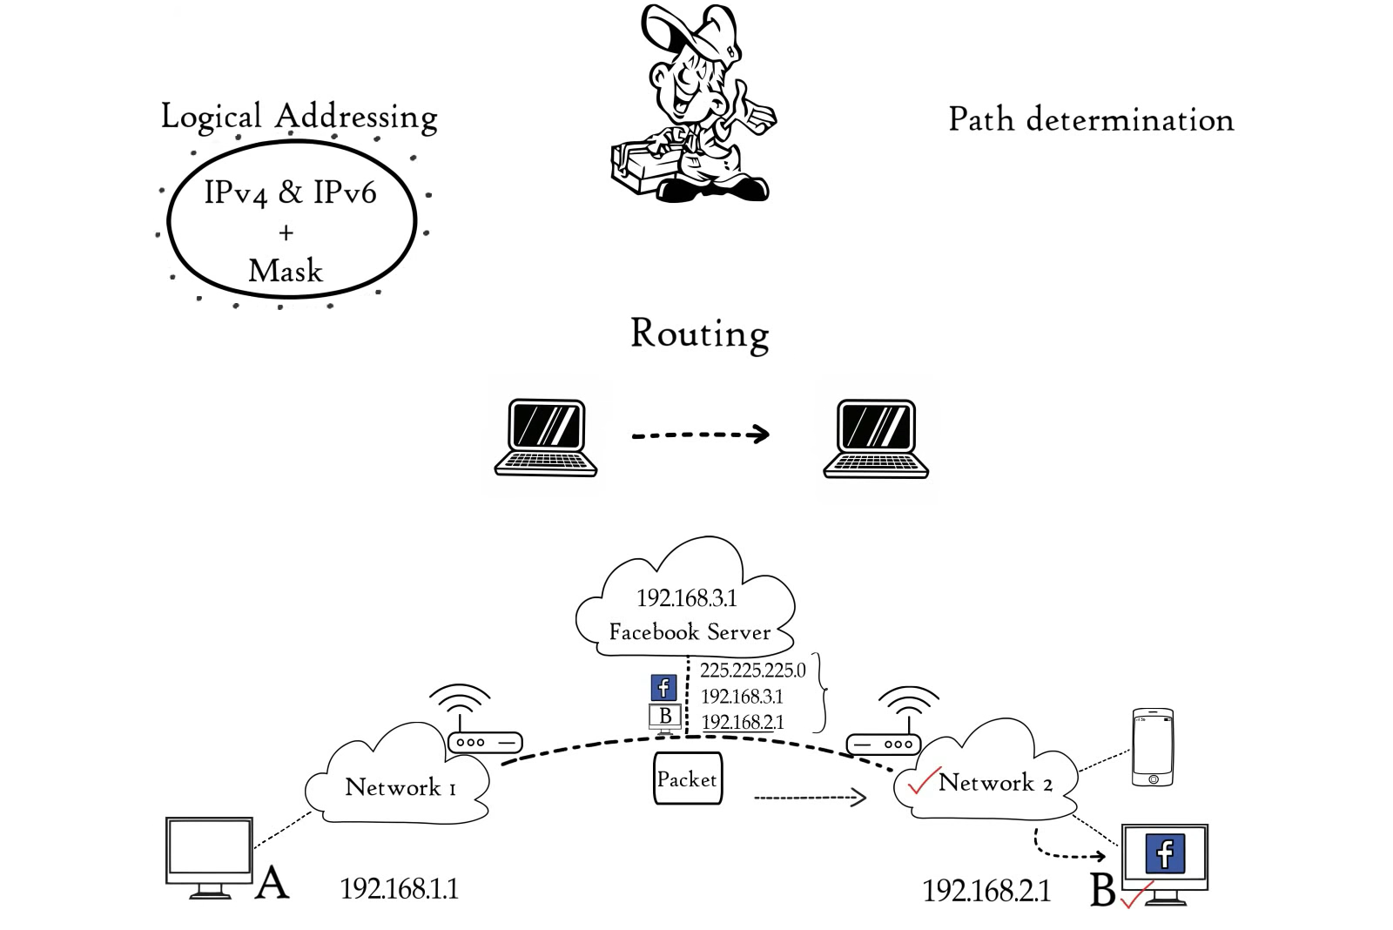

Slide 52
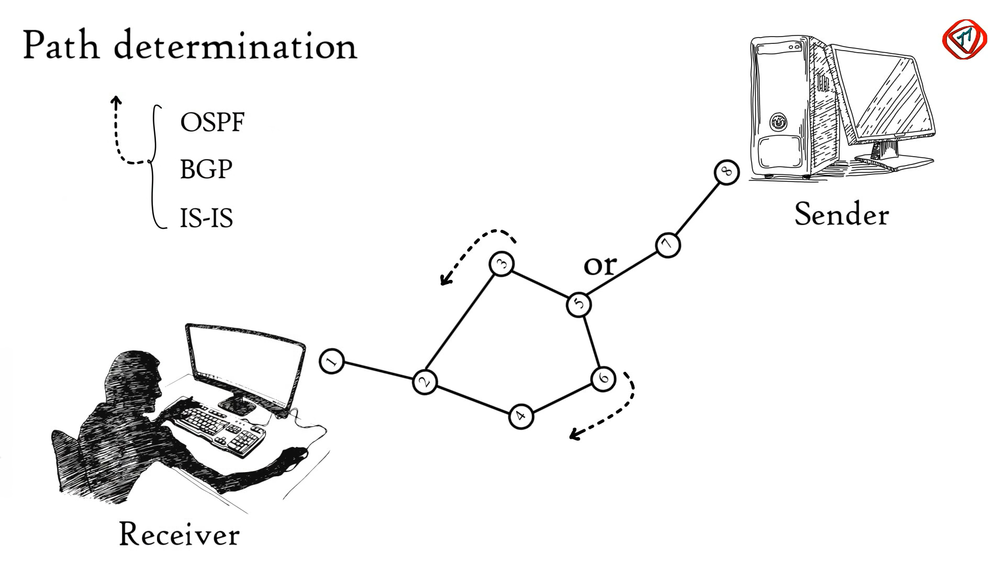

Slide 53
BGP
Border Gateway Protocol (BGP) is the postal service of the Internet. When someone drops a letter into a mailbox, the Postal Service processes that piece of mail and chooses a fast, efficient route to deliver that letter to its recipient.
Similarly, when someone submits data via the Internet, BGP is responsible for looking at all of the available paths that data could travel and picking the best route, which usually means hopping between autonomous systems.
BGP is the protocol that makes the Internet work by enabling data routing. When a user in Singapore loads a website with origin servers in Argentina, BGP is the protocol that enables that communication to happen quickly and efficiently.

Slide 54
OSPF
Open Shortest Path First (OSPF) is a link-state routing protocol that is used to find the best path between the source and the destination router using its own Shortest Path First).
OSPF is developed by Internet Engineering Task Force (IETF) as one of the Interior Gateway Protocol (IGP), i.e, the protocol which aims at moving the packet within a large autonomous system or routing domain.
OSPF divides the autonomous systems into areas where the area is a collection of networks, hosts, and routers. Like internet service providers divide the internet into a different autonomous system for easy management and OSPF further divides the autonomous systems into Areas.

Slide 55
LAYER-4 Transport Layer
The transport layer provides services to the application layer and takes services from the network layer.
The data in the transport layer is referred to as Segments.
It is responsible for the End to End Delivery of the complete message.
The transport layer also provides the acknowledgment of the successful data transmission and re-transmits the data if an error is found.

Slide 56
At the sender’s side: The transport layer receives the formatted data from the upper layers, performs Segmentation, and also implements Flow & Error control to ensure proper data transmission. It also adds Source and Destination port numbers in its header and forwards the segmented data to the Network Layer.
At the receiver’s side: Transport Layer reads the port number from its header and forwards the Data which it has received to the respective application. It also performs sequencing and reassembling of the segmented data.

Slide 57
Functions of the Transport Layer
Segmentation and Reassembly: This layer accepts the message from the (session) layer, and breaks the message into smaller units. Each of the segments produced has a header associated with it. The transport layer at the destination station reassembles the message.
Service Point Addressing: To deliver the message to the correct process, the transport layer header includes a type of address called service point address or port address. Thus by specifying this address, the transport layer makes sure that the message is delivered to the correct process.

Slide 58
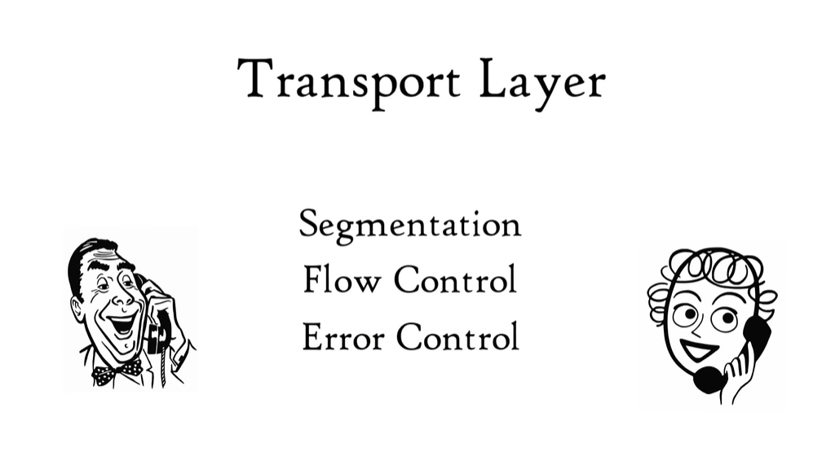

Slide 59
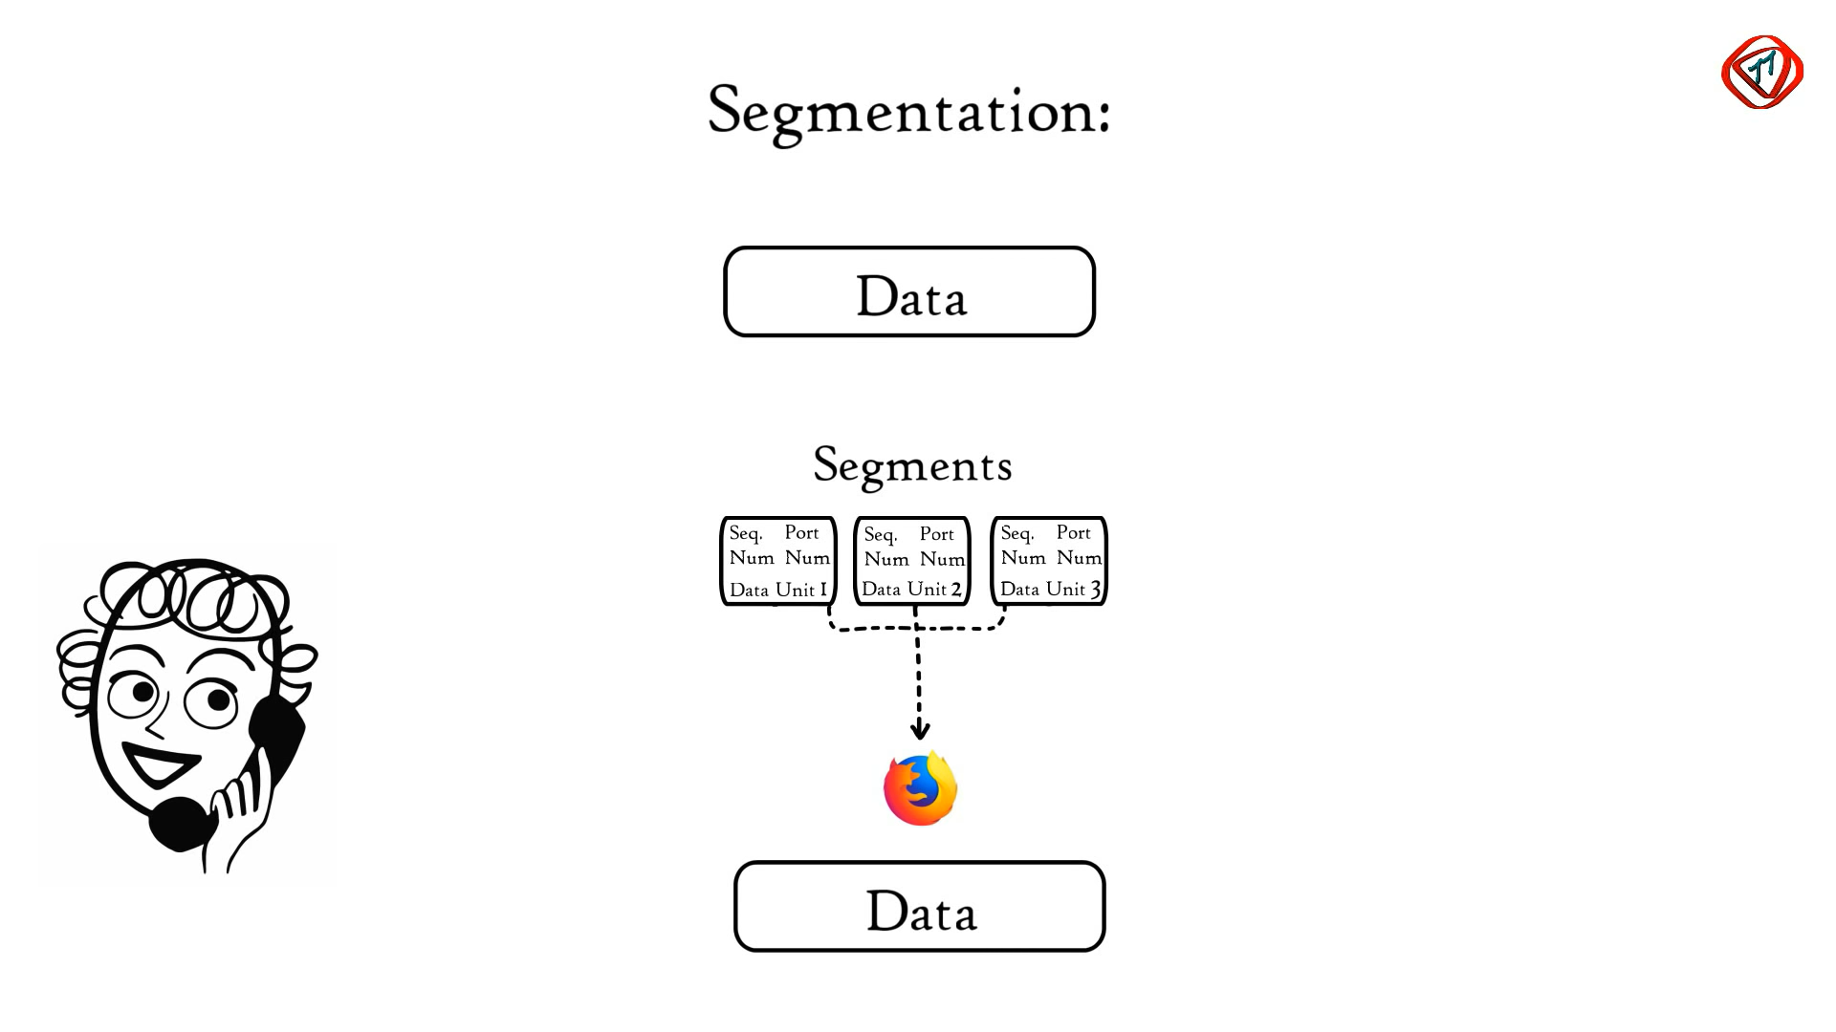
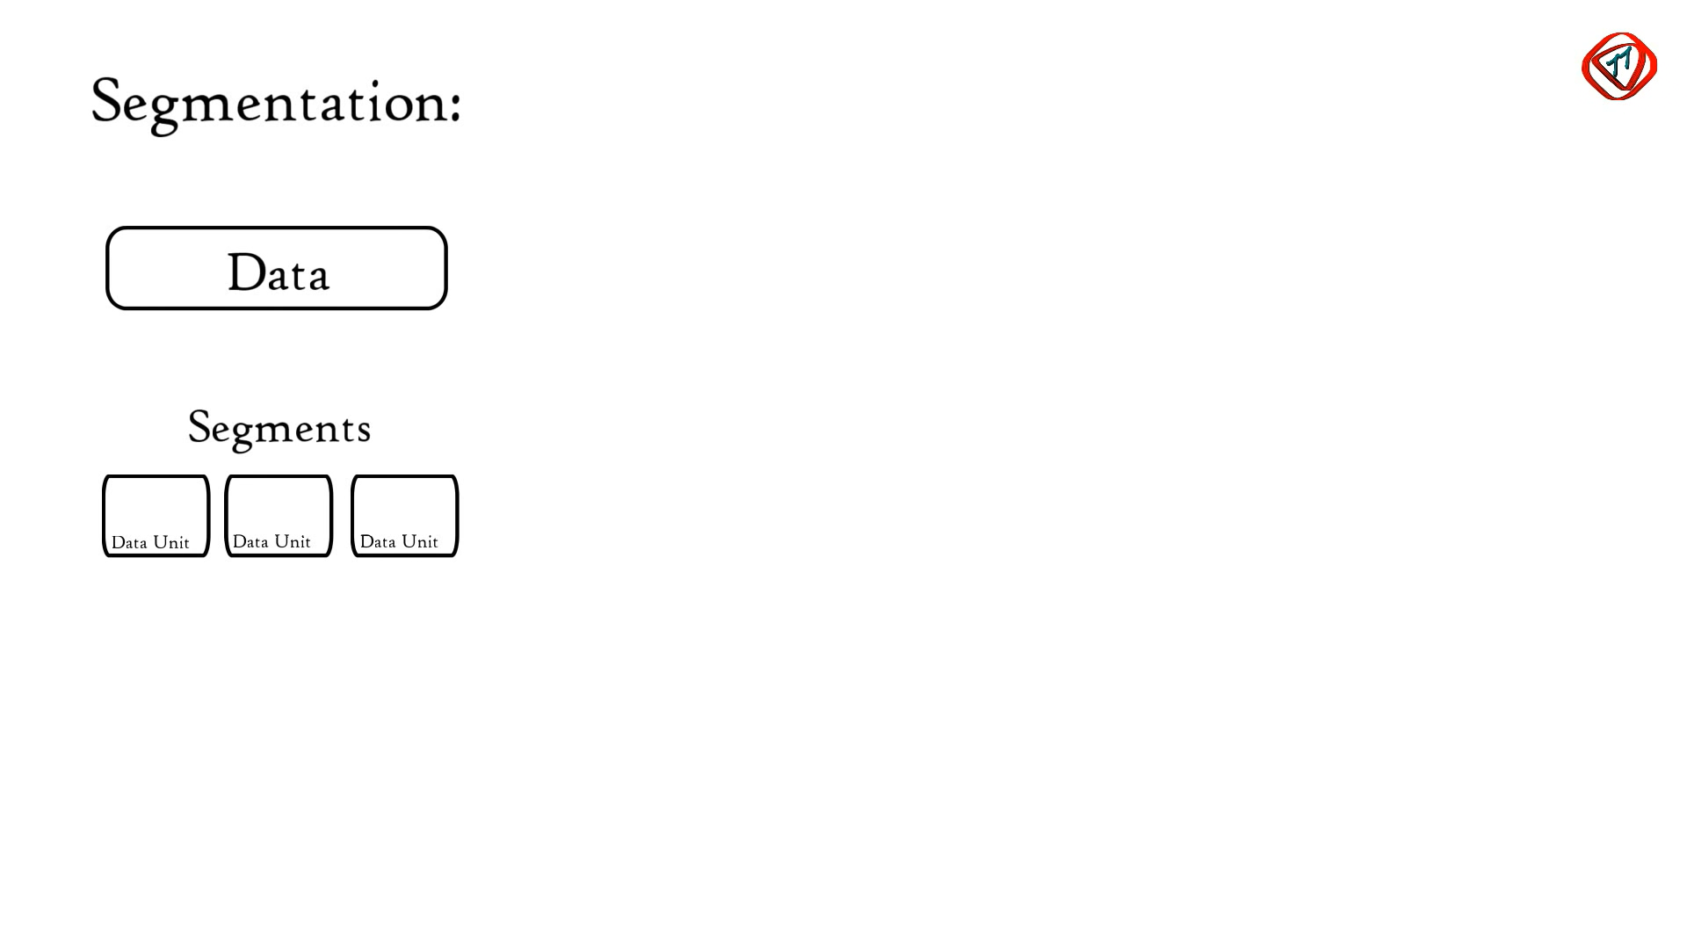

Slide 60
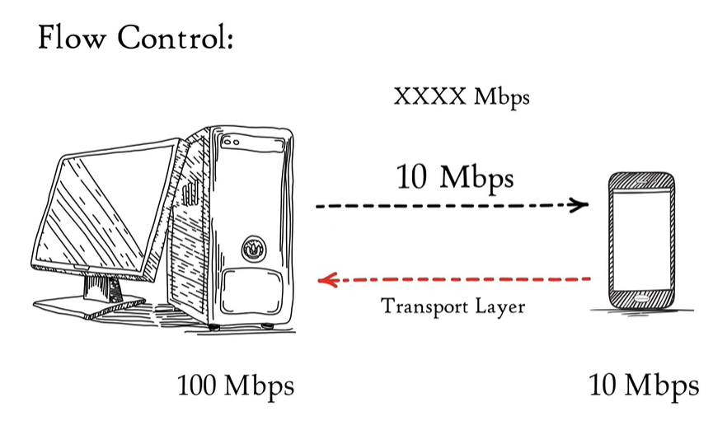
Flow control is used to prevent the sender from overwhelming the receiver. If the receiver is overloaded with too much data, then the receiver discards the packets and asking for the retransmission of packets.

Slide 61
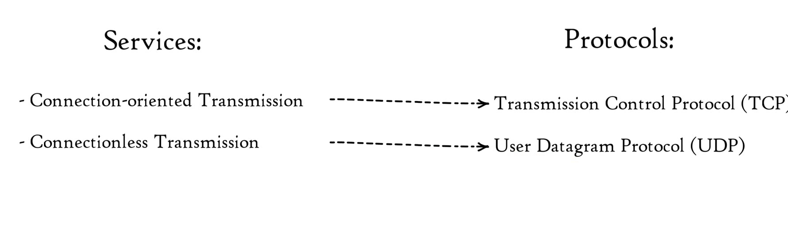
Error Control
The primary role of reliability is Error Control. In reality, no transmission will be 100 percent error-free delivery. Therefore, transport layer protocols are designed to provide error-free transmission.

Slide 62
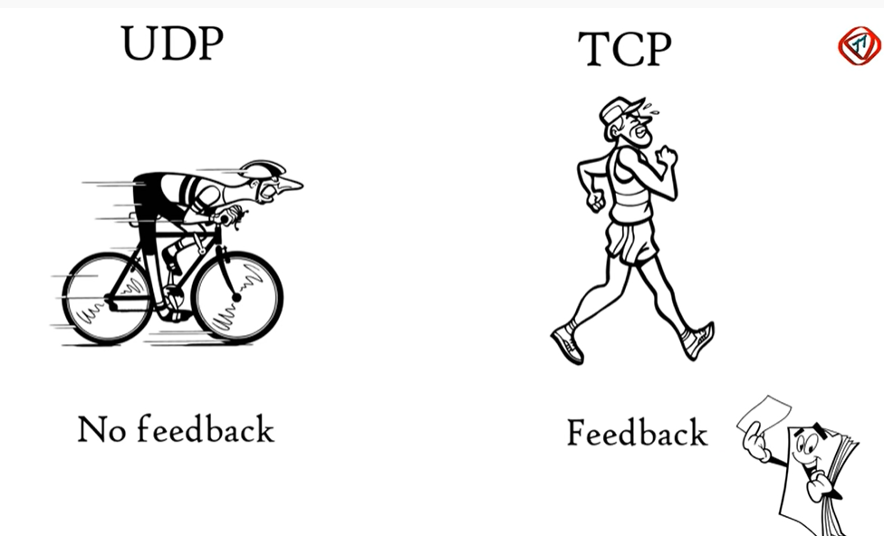

Slide 63
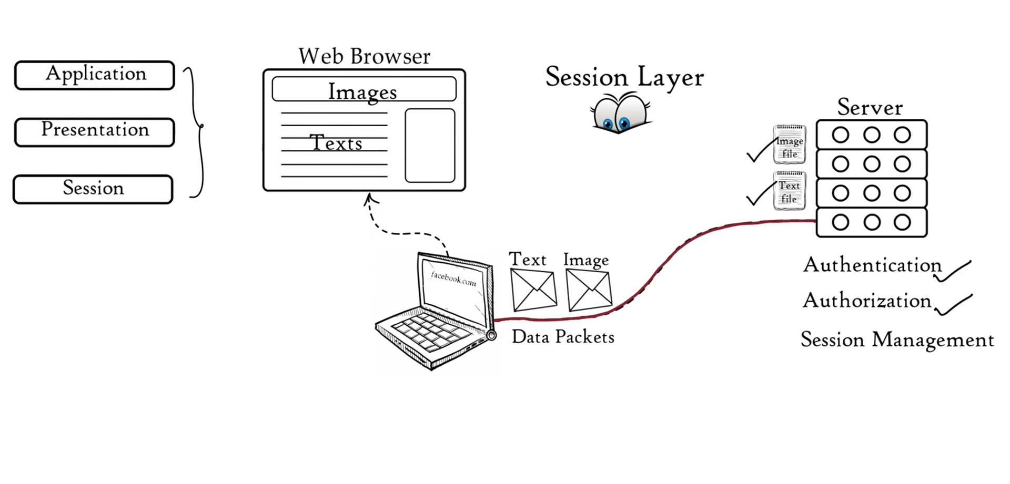
Layer 5- Session Layer
This layer is responsible for the establishment of connection, maintenance of sessions, and authentication, and also ensures security.

Slide 64
Functions of the Session Layer
Session establishment, maintenance, and termination: The layer allows the two processes to establish, use and terminate a connection.
Synchronization: This layer allows a process to add checkpoints that are considered synchronization points in the data. These synchronization points help to identify the error so that the data is re-synchronized properly, and ends of the messages are not cut prematurely and data loss is avoided.
Dialog Controller: The session layer allows two systems to start communication with each other in half-duplex or full-duplex.
Protocols used in the session layer include: Telnet, SSL, SQL, SSH, and SNMP.

Slide 65
Layer 6- Presentation Layer
The presentation layer is also called the Translation layer. The data from the application layer is extracted here and manipulated as per the required format to transmit over the network.
The presentation layer (also referred to as the ‘syntax layer’) transforms data into a form the application layer can digest.
What happens in this layer, typically, is formatting and encrypting data that is sent across the network. Examples of what this layer provides services for include MPEG, GIF, TIFF, ASCII, and encryption.

Slide 66
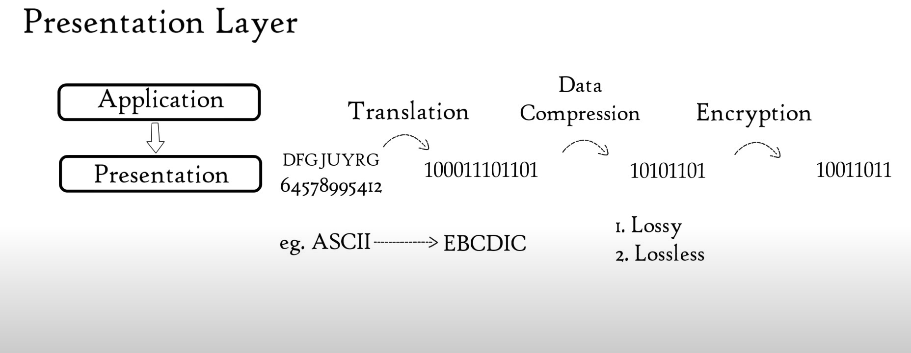

Slide 67
Layer 7- Application Layer
At the very top of the OSI Reference Model stack of layers, we find the Application layer which is implemented by the network applications. These applications produce the data, which has to be transferred over the network. This layer also serves as a window for the application services to access the network and for displaying the received information to the user.
Example: Application – Browsers, Skype Messenger, etc.
Note: The application Layer is also called Desktop Layer.

Slide 68
Functions of the Application Layer are:
Network Virtual Terminal
FTAM- File transfer access and management
Mail Services
Directory Services

Slide 69
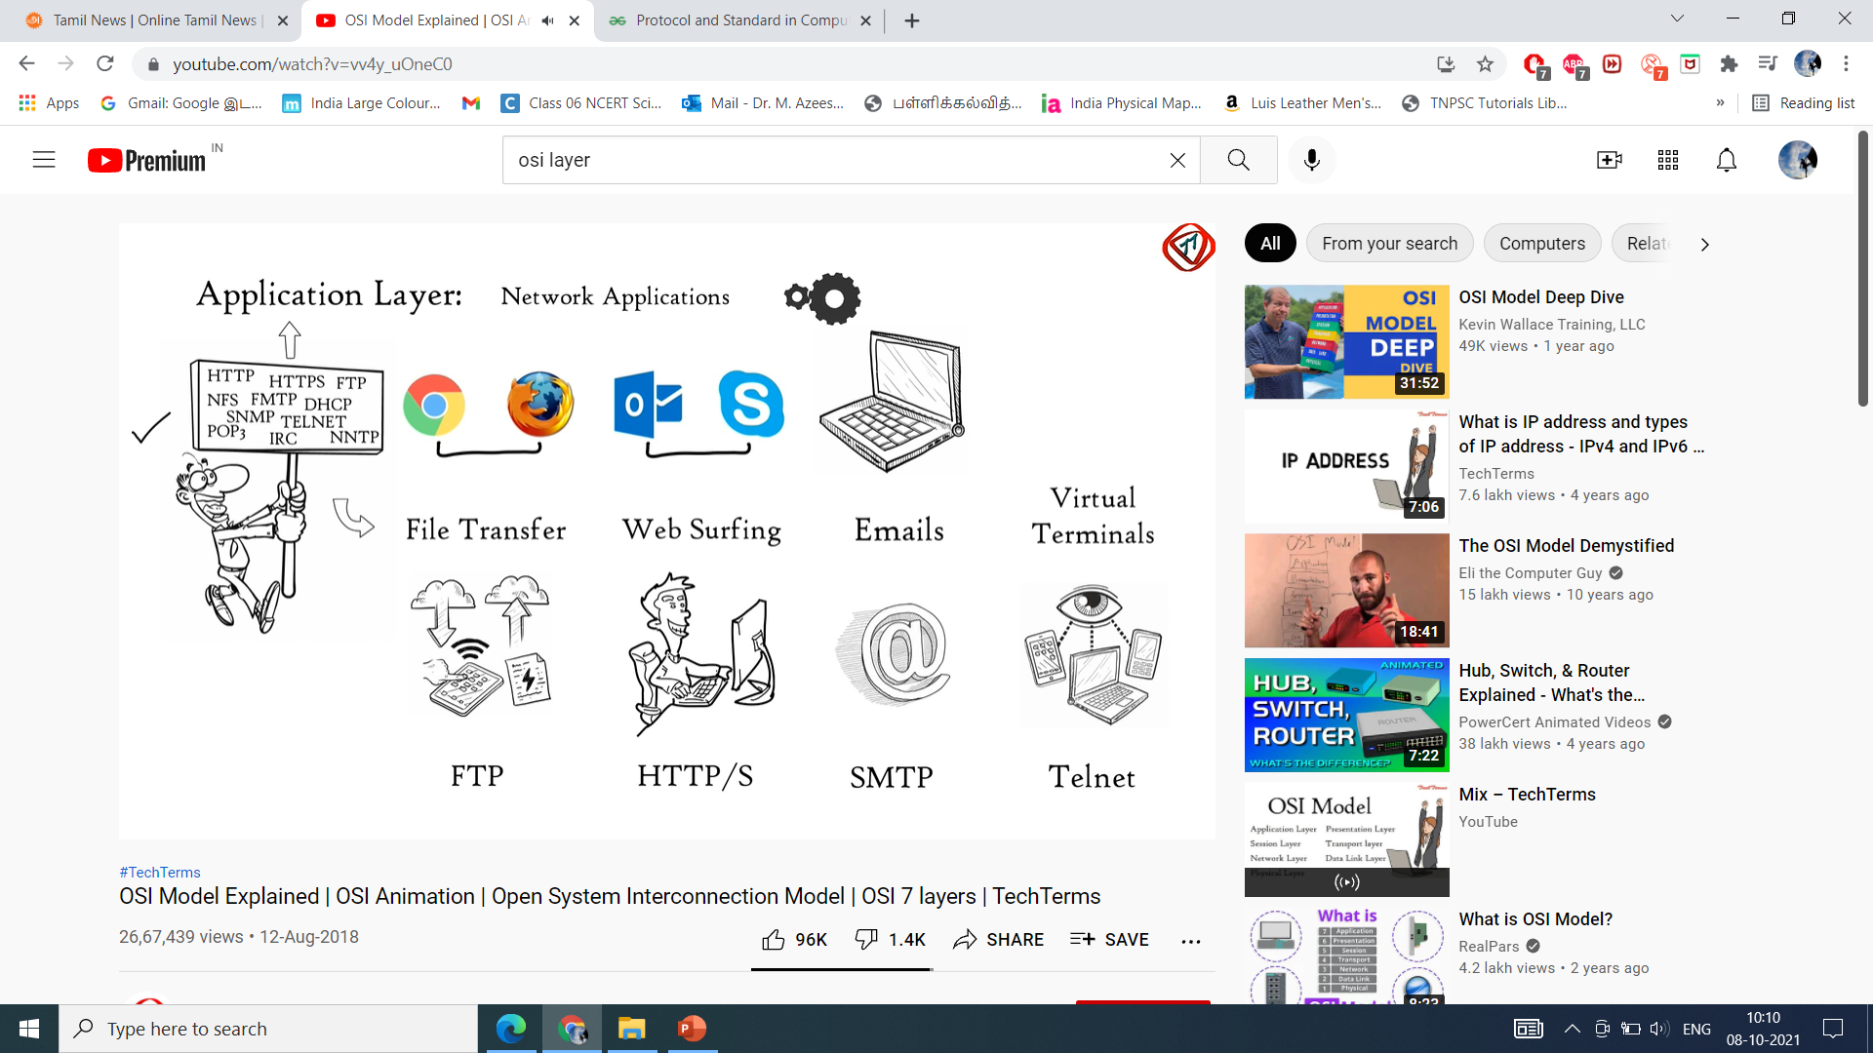

Slide 70
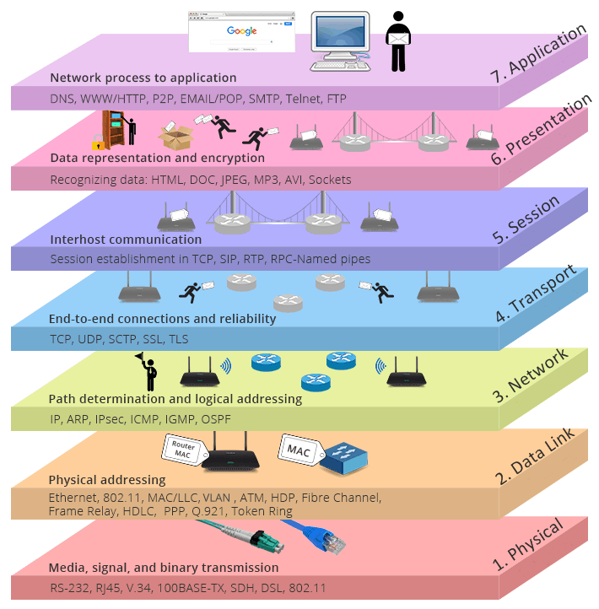
Functions of each layer in OSI model

Slide 71
TCP/IP Suit
Dr. R. Prashanth

Slide 72
Introduction
The TCP/IP model was created in the 1970s by the Defense Advance Research Project Agency (DARPA) as an open, vendor-neutral, public networking model.
Like the OSI model, it describes general guidelines for designing and implementing computer protocols.
The Internet Protocol Suite (commonly known as TCP/IP) is the set of communications protocols used for the Internet and other similar networks.
The TCP/IP model is a concise version of the OSI model.

Slide 73
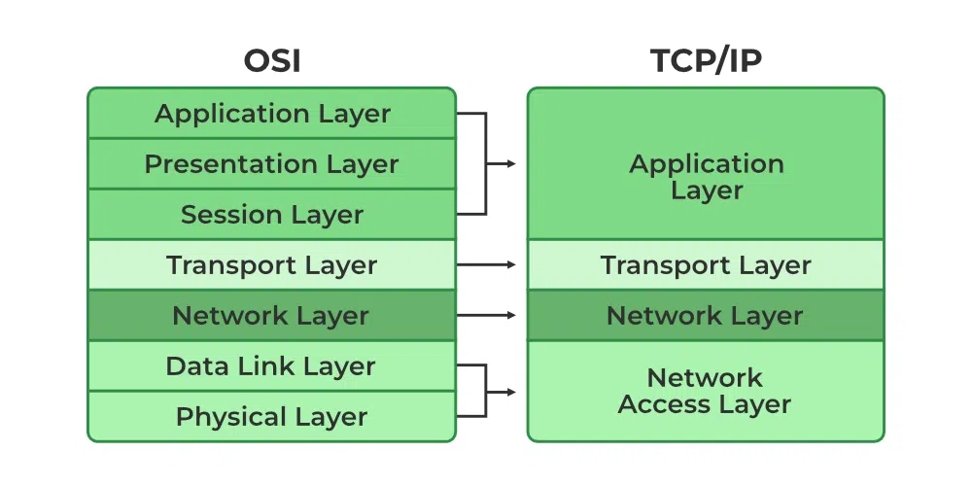
OSI vs TCP

Slide 74
It is named from two of the most important protocols in it:
the Transmission Control Protocol (TCP) and
the Internet Protocol (IP), which were the first two networking protocols defined in this standard.
It consists of four layers:
Network Access,
Internet,
Transport, and
Application layer

Slide 75
Layers of TCP/IP
The application layer provides applications with standardized data exchange. Its protocols include HTTP, FTP, Post Office Protocol 3, Simple Mail Transfer Protocol and Simple Network Management Protocol. At the application layer, the payload is the actual application data.
The transport layer is responsible for maintaining end-to-end communications across the network. TCP handles communications between hosts and provides flow control, multiplexing and reliability. The transport protocols include TCP and User Datagram Protocol, which is sometimes used instead of TCP for special purposes.

Slide 76
Key difference between OSI vs TCP/IP
OSI Model | TCP/IP Model
It stands for Open System Interconnection. | It stands for Transmission Control Protocol.
OSI model has been developed by ISO (International Standard Organization). | It was developed by ARPANET (Advanced Research Project Agency Network).
It is an independent standard and generic protocol used as a communication gateway between the network and the end user. | It consists of standard protocols that lead to the development of an internet. It is a communication protocol that provides the connection among the hosts.
In the OSI model, the transport layer provides a guarantee for the delivery of the packets. | The transport layer does not provide the surety for the delivery of packets. But still, we can say that it is a reliable model.
This model is based on a vertical approach. | This model is based on a horizontal approach.
In this model, the session and presentation layers are separated, i.e., both the layers are different. | In this model, the session and presentation layer are not different layers. Both layers are included in the application layer.
It is also known as a reference model through which various networks are built. For example, the TCP/IP model is built from the OSI model. It is also referred to as a guidance tool. | It is an implemented model of an OSI model.
In this model, the network layer provides both connection-oriented and connectionless service. | The network layer provides only connectionless service.
Protocols in the OSI model are hidden and can be easily replaced when the technology changes. | In this model, the protocol cannot be easily replaced.
It consists of 7 layers. | It consists of 4 layers.
OSI model defines the services, protocols, and interfaces as well as provides a proper distinction between them. It is protocol independent. | In the TCP/IP model, services, protocols, and interfaces are not properly separated. It is protocol dependent.
The usage of this model is very low. | This model is highly used.
It provides standardization to the devices like router, motherboard, switches, and other hardware devices. | It does not provide the standardization to the devices. It provides a connection between various computers.

Slide 77
The network layer, also called the internet layer, deals with packets and connects independent networks to transport the packets across network boundaries. The network layer protocols are IP and Internet Control Message Protocol, which is used for error reporting.
The physical layer, also known as the network interface layer or data link layer, consists of protocols that operate only on a link -- the network component that interconnects nodes or hosts in the network. The protocols in this lowest layer include Ethernet for local area networks and Address Resolution Protocol.

Slide 78
How it works
TCP/IP specifies how data is exchanged over the internet by providing end-to-end communications that identify how it should be broken into packets, addressed, transmitted, routed and received at the destination.
TCP/IP requires little central management and is designed to make networks reliable with the ability to recover automatically from the failure of any device on the network.
TCP/IP uses the client-server model of communication in which a user or machine (a client) is provided a service, like sending a webpage, by another computer (a server) in the network.
Collectively, the TCP/IP suite of protocols is classified as stateless, which means each client request is considered new because it is unrelated to previous requests. Being stateless frees up network paths so they can be used continuously.

